Slide 1
Goniometrické funkcie
Sin, cos

Slide 2
C
a– odvesna protiľahlá k uhlu α
b– odvesna priľahlá k uhlu α
c – prepona
α – ostrý uhol < 90 ⁰
b
a
α
A
B
c
sin α = a/b
cos α= c/b
tg α = a/b
cotg α = b/a
Goniometria ostrého uhla v pravouhlom trojuholníku

Slide 3
Stupne , radiány
I. kvadrant
II. kvadrant
III. kvadrant
IV. kvadrant
Stup- ne | 0 | 30 | 45 | 60 | 90 | 120 | 135 | 150 | 180 | 210 | 225 | 240 | 270 | 300 | 315 | 330 | 360
Radiá- ny | 0 | π/6 | π/4 | π/3 | π/2 | 2/3π | 3/4π | 5/6π | π | 7/6π | 5/4π | 4/3π | 3/2π | 5/3π | 7/4π | 11/6π | 2π
Prevod stupňov na radiány:
α= x . 180 / π
Prevod radiánov na stupne :
x = α . π / 180

Slide 4
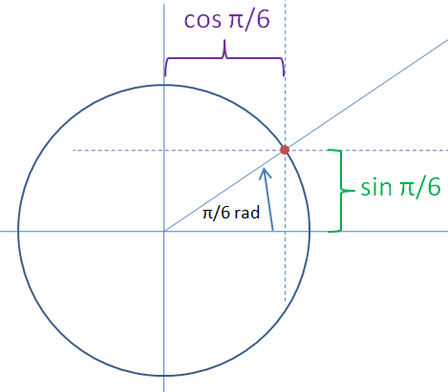
90 ⁰
0 ⁰ - 0 radiánov
90 ⁰ - π/2
180 ⁰ - π
270 ⁰ - 2/3π
360 ⁰ - 2π
180 ⁰
0 ⁰
360⁰
270⁰
α

Slide 5
Funkcia sínus sin x
Sínusoida
1
II.
I.
I.
II.
3/2 π
2π
0
0
π
π /2
III.
IV.
III.
IV.
- 1
I. | II. | III. | IV.
0 – 90⁰ | 90 - 180⁰ | 180-270⁰ | 270-360⁰
+ | + | - | -
rastie | klesá | klesá | rastie
0 ⁰ | 90 ⁰ | 180 ⁰ | 270 ⁰ | 360
0 | π/2 | π | 3/2 π | 2π
0 | 1 | 0 | - 1 | 0

Slide 6
Funkcia kosínus cos x
1
II.
I.
0
π /2
π
3/2 π
2π
III.
IV.
-1
I. | II. | III. | IV.
0 – 90⁰ | 90 - 180⁰ | 180-270⁰ | 270-360⁰
+ | - | - | +
klesá | klesá | rastie | rastie
0 ⁰ | 90 ⁰ | 180 ⁰ | 270 ⁰ | 360
0 | π/2 | π | 3/2 π | 2π
1 | 0 | -1 | 0 | 1

